Slide 1
Python for Physical Sciences Tutorial 4, Part Two: Working with Image Data

Slide 2
Image data
So far we have worked with effectively 1-dimensional data, or a linear series of values.
Image data is 2-dimensional; values are in a grid rather than a series, so:
How do we store and use this data in our program?
How do we display this data in plots we make?
How do we save and retrieve this data?
1 | 1 | 1 | 1 | 1
1 | 2 | 2 | 1 | 1
2 | 3 | 4 | 2 | 2
2 | 2 | 3 | 2 | 1
1 | 2 | 2 | 1 | 1

Slide 3
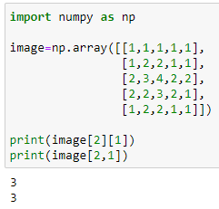

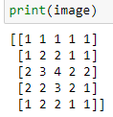

Storing image data
We can define an array where each element is another array.
i.e. -> image=np.array([[0,0…],[0,0…],[0,1…]…])
This is similar to the nested lists described earlier.
We access specific elements with a set of bracketed integers, for example -> image[2][1]. Or we could use image[2,1].
The first integer denotes the sub-array, while the second selects an element in that array.
This is like selecting a row then a column, or y then x.
2d arrays work similar to 1d arrays with mathematical operators.
When applying specific mathematical functions however (such as sin or cos), we can usually only use those in numpy.

Slide 4
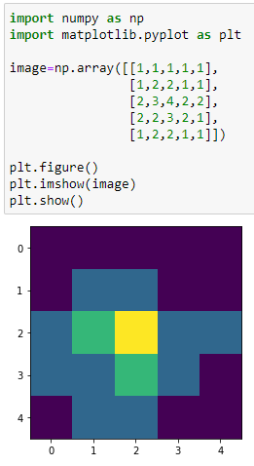
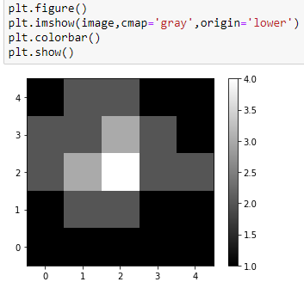
Plotting image data
We can use the ‘imshow’ function in matplotlib.
-> plt.imshow(image)
Add a colourbar to indicate data values.
-> plt.colorbar()
We can also change some style options, for example:
Convert to greyscale with cmap=‘gray’
Change the origin to the lower left with origin=‘lower’
-> plt.imshow(image,cmap=‘gray’,origin=‘lower’)
Other useful arguments in plt.imshow() for photometry:
Vmax: set an upper limit for pixel values.
Vmin: set a lower limit for pixel values.

Slide 5
Saving image data
Most astronomers use the FITS (‘Flexible Image Transport System’) file format for image data.
We need specific functions in the astropy package to manage this type of file:
-> from astropy.io import fits
File management is simple:
Save image data -> fits.writeto(‘imageName.fits’,image)
Open image data -> image=fits.getdata(‘imageName.fits’)

Slide 6
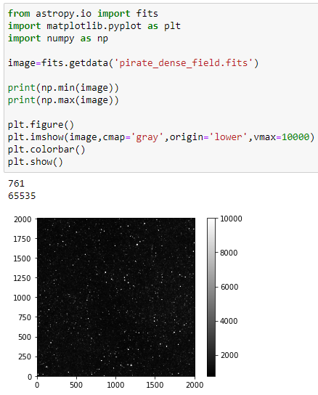
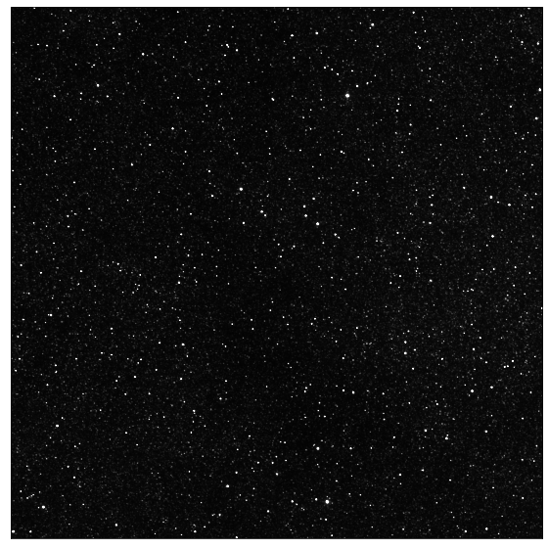
Real example – an image from PIRATE

